Slide 1
Chapter 4: Data Models

Slide 2
In this chapter, you will learn:
Why data models are important
About the basic data-modeling building blocks
What business rules are and how they affect database design
How the major data models evolved, and their advantages and disadvantages
How data models can be classified by level of abstraction

Slide 3
Data Model and Data Modeling
Data model is a representation, usually graphical, of a real-world data structure.
Data modeling refers to the process of creating a specific data model for a problem to determine what data and relationships should be stored in the database.
Two major data models in use today are:
Entity-Relationship Model (ERD)
Class Diagram (Object-Oriented)

Slide 4
The Importance of Data Models
As a communication tool to facilitate interaction among system designers, applications programmers, and end users.
Good database design uses an appropriate data model as its foundation. reduce redundancy, eliminate anomalies
End-users have different views of data. Data model provides the whole view of data.
Data model organizes data for various users who have different needs for data.

Slide 5
Business Rules
A business rule is a brief, precise, and unambiguous description of a policy, procedure, or principle within a specific organization.
The main sources of business rules are company managers, policy makers, department managers, and written documentation such as a company’s procedures, standards, and operations manuals.
A faster and more direct source of business rules is direct interviews with end users. Unfortunately, because perceptions differ, end users are sometimes a less reliable source when it comes to specifying business rules. Interviews with several people who perform the same job often get different perceptions of what the job components are.

Slide 6
Examples of Business Rules
A customer may make many payments on account. Each payment on account is credited to only one customer.
A machine operator may not work more than 10 hours in any 24-hour period.
A business trip destination must be at least 100 miles away for an airline ticket to be purchased.
A training cannot be scheduled for fewer than 10 employees or for more than 30 employees.
A lab cannot be scheduled for demonstration purposes for more than one-hour per day.
A customer may receive many invoices. Each invoice is received by only one customer.

Slide 7
Importance of Business Rules
They allow the database designer to develop appropriate relationship participation rules and constraints and to create an accurate data model.
They standardize the company’s view of data.
They serve as a communication tool between users and database designers.
They allow database designers to understand the nature, role, and scope of data.
They help designers to understand business processes.

Slide 8
Translating Business Rules into Data Model Components
Data model components are entities (table/relation), attributes (fields/column), relationships, and constraints.
A noun in a business rule will translate into an entity in data model.
A verb (active or passive) that associates the nouns will translate into a relationship among the entities.
For example, the business rule “a customer may generate many invoices” contains two nouns (customer and invoices) and a verb (generate) that associates the nouns. From this business rule, you could deduce the following:
Customer and invoice are entities.
There is a generate relationship between customer and invoice.

Slide 9
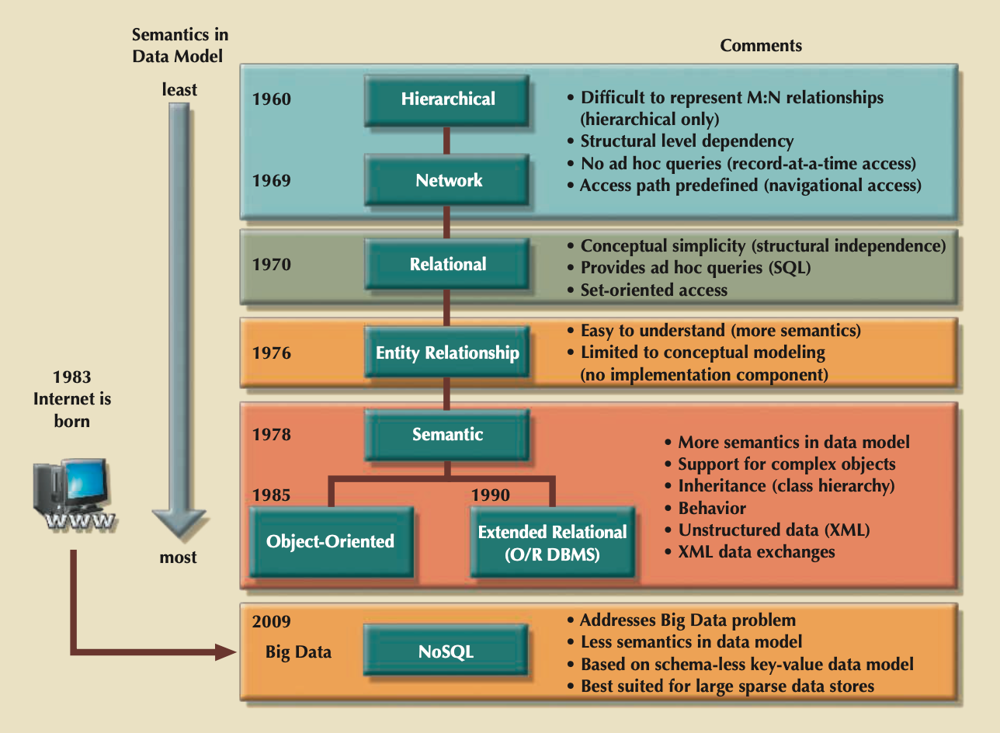
Evolution of Data Models

Slide 10
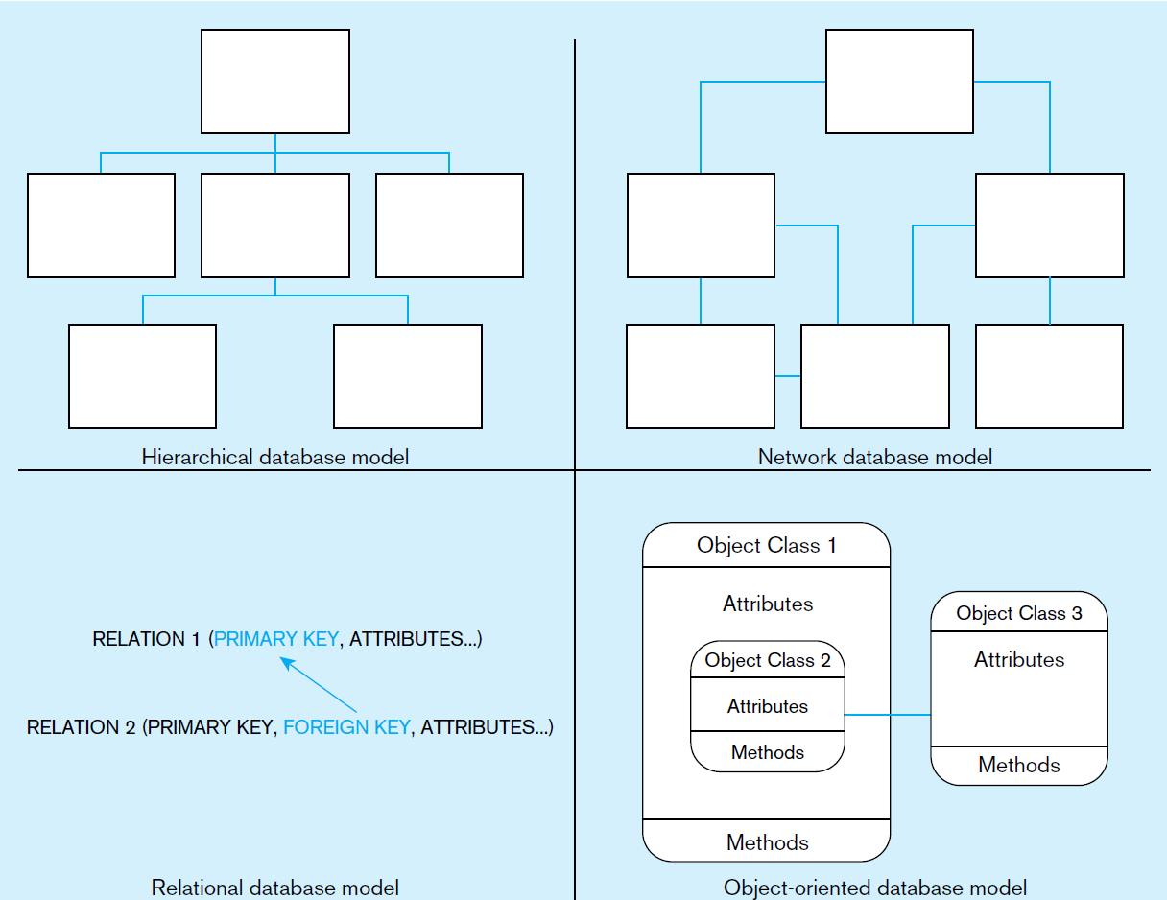
Evolution of Data Models

Slide 11
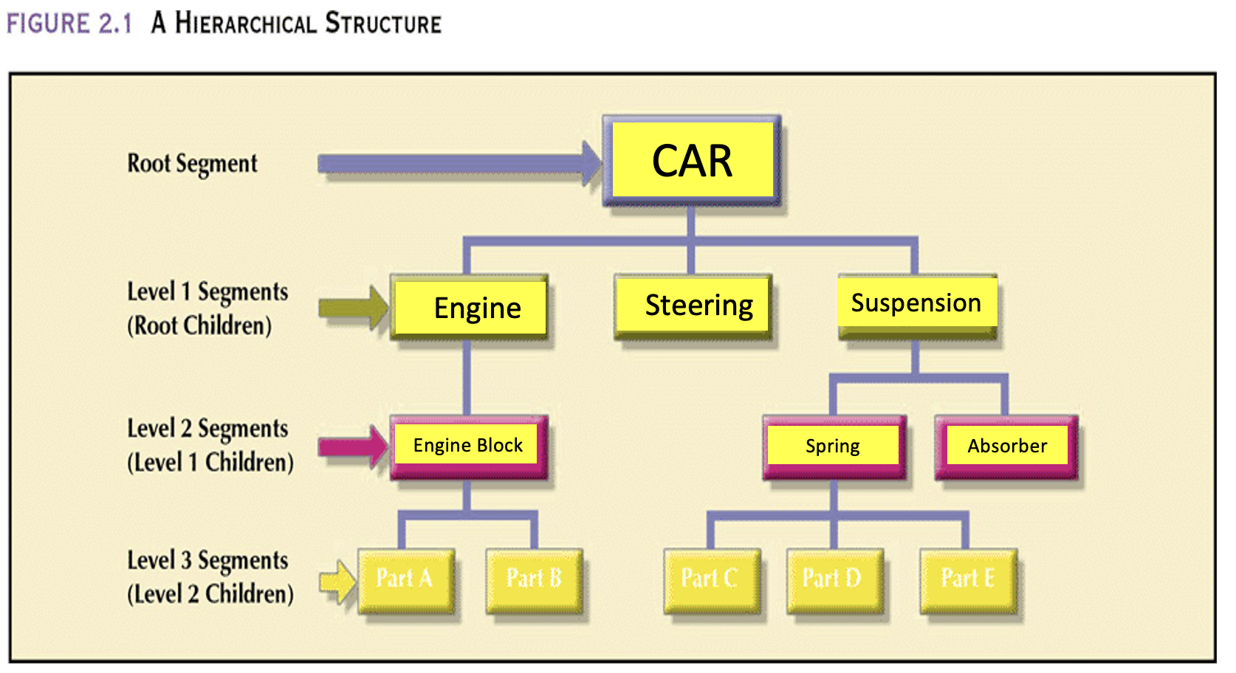
A Hierarchical Structure

Slide 12
Characteristics of Hierarchical Model
Hierarchical model is based on an upside-down tree structure which contains levels or segments.
Within the hierarchy, a higher layer is perceived as the parent of the segment directly below it, which is called the child.
Each parent can have many children.
Each child has only one parent.
A tree is defined by the path that traces the parent segments to child segments.

Slide 13
The Hierarchical Model
Advantages
Conceptual simplicity
Database security
Data independence
Database integrity
Efficiency
Disadvantages
Complex implementation
Difficult to manage
Lacks structural independence
Complex applications programming and use
Implementation limitations
Lack of standards

Slide 14
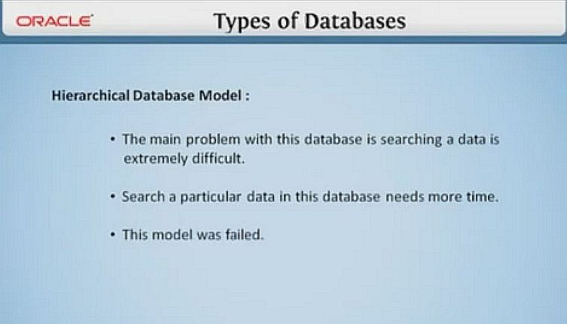
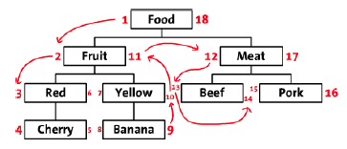
The Hierarchical Model
Preorder traversal or hierarchic sequence “Left-list” path takes 18 steps to find “Pork” and return its value.

Slide 15
The Network Model
Network model was created to
Represent complex data relationships more effectively.
Improve database performance.
Impose a database standard.
Unlike the hierarchical model, the network model allows a record to have more than one parent.
While the network database model is generally not used today, the definitions of standard database concepts that emerged with the network model are still used by modern data models. E.g., schema, subschema, DML, and DDL.

Slide 16
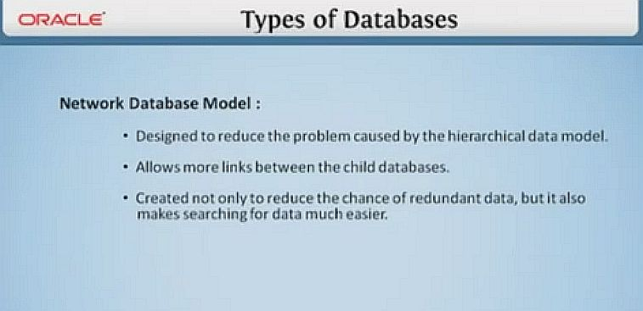
The Network Model

Slide 17
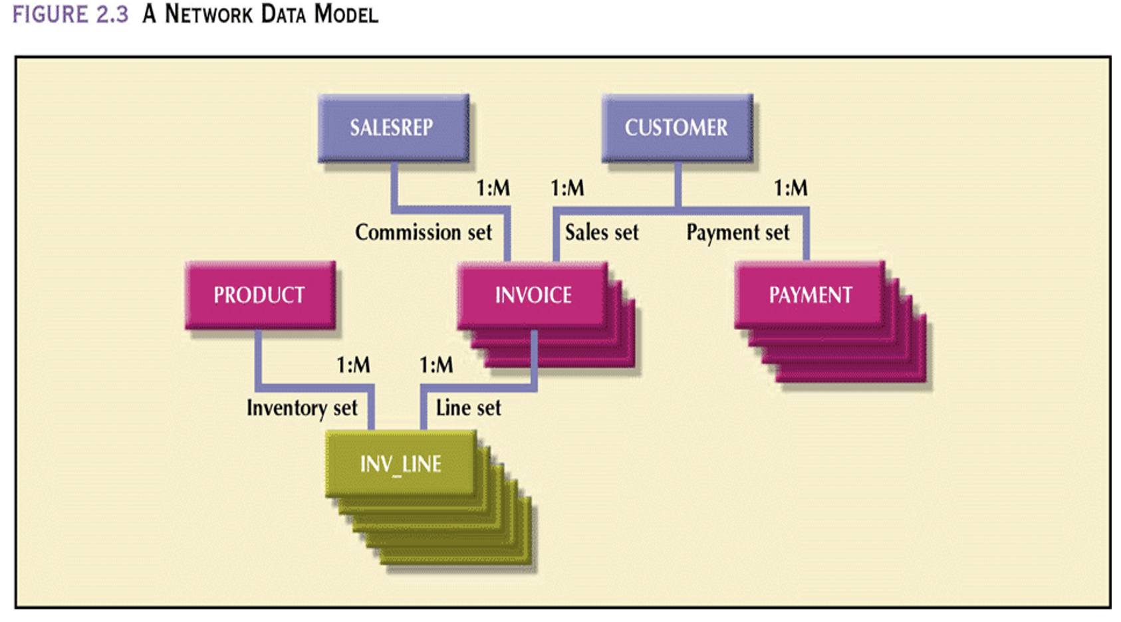
A Network Data Model

Slide 18
The Network Data Model
Advantages
Conceptual simplicity
Handles more relationship types
Data access flexibility
Promotes database integrity
Data independence
Conformance to standards
Disadvantages
System complexity
Lack of structural independence

Slide 19
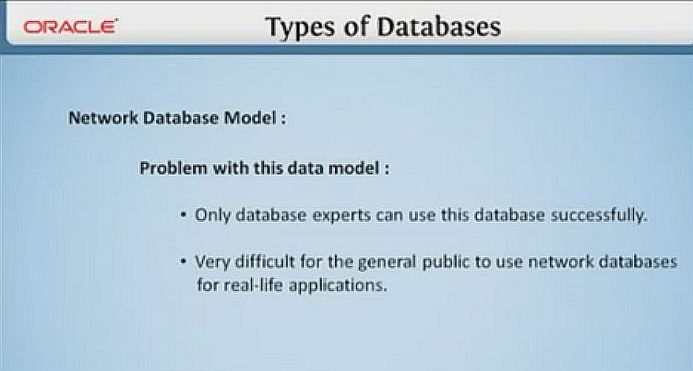
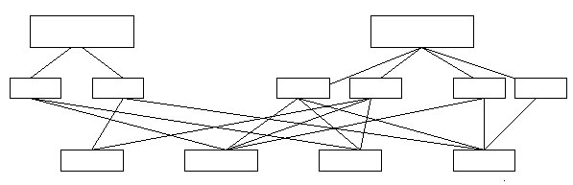
The Network Model

Slide 20
The Relational Model
A table (sometimes called a relation) is a two-dimensional structure composed of intersecting rows and columns. Each row in a table is called a record (or tuple). Each column represents an attribute.
The relational data model is implemented through a very sophisticated relational database management system (RDBMS). The RDBMS performs the same basic functions provided by the hierarchical and network DBMS systems, in addition to other functions that make the relational data model easier to understand and implement.

Slide 21
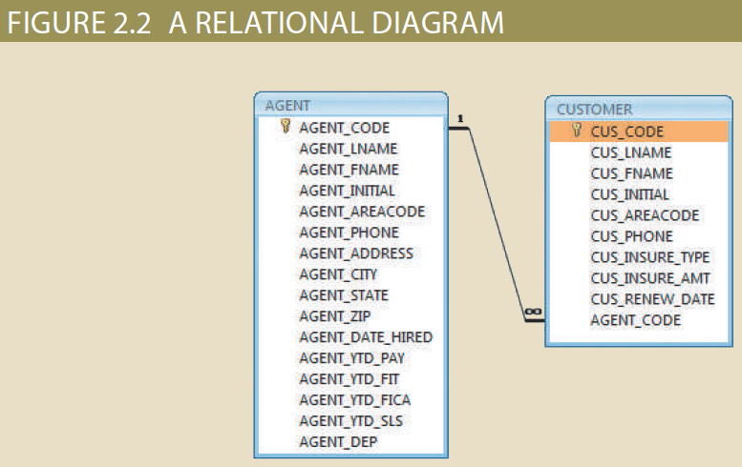
A Relational Diagram
A relational diagram is a representation of the relational database’s entities, the attributes within those entities, and the relationships between those entities.
‹#›

Slide 22
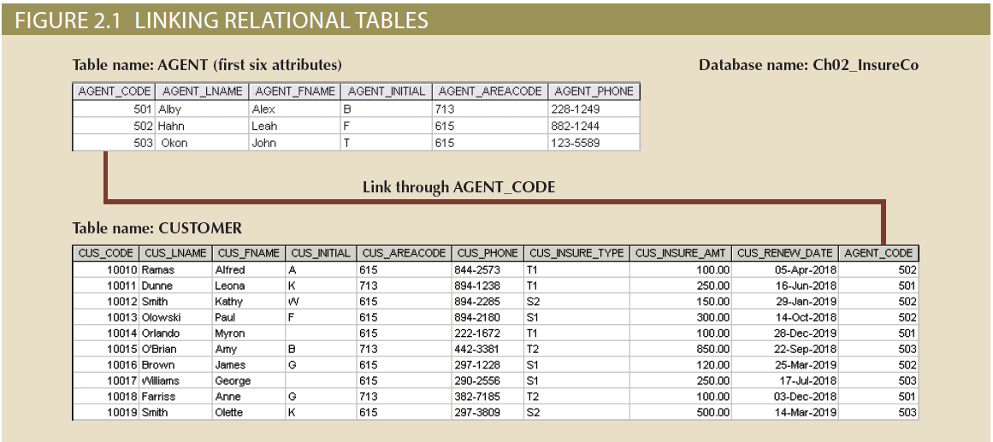
Linking Relational Tables
‹#›

Slide 23
Relational Table
A relational table stores a collection of related entities. In this respect, the relational database table resembles a file, but there is a crucial difference between a table and a file: a table yields complete data and structural independence because it is a purely logical structure. How the data is physically stored in the database is of no concern to the user or the designer; the perception is what counts.

Slide 24
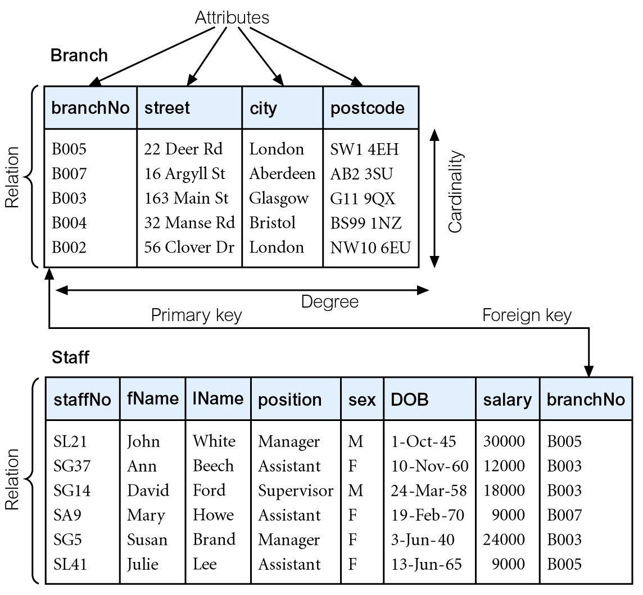
The Relational Model
Data and relationships are represented by a collection of tables.
Each table has a number of columns with unique names, e.g. customer, account.

Slide 25
The Relational Model
Advantages
Structural independence
Improved conceptual simplicity
Easier database design, implementation, management, and use
Ad hoc query capability through the use of SQL
Powerful database management system

Slide 26
The Relational Model
Disadvantages
Substantial hardware and system software overhead
Can facilitate poor design and implementation
May promote “islands of information” problems

Slide 27
The Entity Relationship Model
Widely accepted and adapted graphical tool for data modeling
Graphical representation of entities and their relationships in a database structure.
A top-down approach to data modeling.

Slide 28
Building Blocks of Data Model
Customer
Region
Supplier
Entities
Order
Product
Relationships
Despatch Note

Slide 29
Entity
Meaning. A class of persons, places, objects, events, or concepts about which we need to capture and store data (crudely, it is a file and described using a noun).
Examples : customers, products, suppliers, employees, departments
Using singular or plural nouns is a matter of preference
Notation - it is represented by a rectangle.
ORDER

Slide 30
What Should an Entity Be?
SHOULD BE:
An object that will have many instances in the database
An object that will be composed of multiple attributes
An object that we are trying to model
SHOULD NOT BE:
A user of the database system
An output of the database system (e.g. a report)

Slide 31
More Examples of Entities
Persons : agency, contractor, customer, department, division, employee, instructor, student, supplier
Places : sales region, building, room, branch office, campus
Objects : book, machine, part, product, raw material, software license, software package, tool, vehicle model, vehicle
Events : application, award, cancellation, class, flight, invoice, order, registration, renewal, requisition, reservation, sale, trip
Concepts : account, block of time, bond, course, fund, qualification, stock

Slide 32
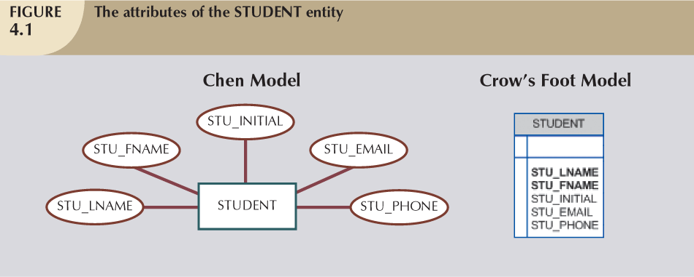
Attributes
Meaning - is a characteristic, data field, or data element of an entity. There are many attributes for each entity.
Example – Customer’s attributes are name, address, telephone, email.
Notation:
DBDL or Textual notation
STUDENT (STU_ID, STU_LNAME, STU_FNAME, STU_INITIAL, STU_EMAIL, STU_PHONE)

Slide 33
Relationship
Meaning. The lines between the entities (boxes) representing relationships between them
Example. Between CUSTOMER and ORDER
Notation. The relationship is indicated by lines connecting the entities. There’s a “crow’s” foot or a diamond shaped box
Description : A relationship is read in two directions (left and right). Example : Each customer places many orders, and each order is placed by only one customer.
Customer
makes
Order
Customer
Order

Slide 34
Exercise for Students
List 4 appropriate entities for each of the following systems :
Inventory System
Human Resource System
Purchasing System
For each of the entities, list 4 attributes

Slide 36
Inventory System
Product (ProductID, Name, SKU, Quantity, Price) **SKU → Stock Keeping Unit
Warehouse (WarehouseID, Location, Capacity, Personnel)
Supplier (SupplierID, Name, ContactNo, DeliveryTime, ProductCatalogue)
Order (OrderID, OrderDate, Quantity, Status, DeliveryInformation)
Human Resource System
Employee (EmployeeID, EmployeeName, ContactInformation, JobTitle, Salary)
Department (DepartmentID, DepartmentName, Manager, Budget, Goals)
Job Position (JobID, Title, JobDescription, SkillsRequired, SalaryRange)
Performance Review (PerformanceID, Date, PerformanceGoals, Feedback, Rating)
Purchasing System
Vendor (VendorID, Name, Contact information, Product offerings, Lead time)
Purchase Order (PurchaseOrderID, Number, Date, Vendor, ItemsOrdered)
Budget (BudgetID, Amount, Department, Date, Status)
Shipment (ShippingID, Date, Quantity, Vendor, PurchaseOrderNumber)

Slide 37
Types of Relationships with Examples
ONE-TO-ONE:
STUDENT
ID
1
1
1
1
CLASS
ONE-TO-MANY:
1
M
1
1
STUDENT
A
STUDENT
B
STUDENT
C
CLASS
1
CLASS
2
MANY-TO-MANY:
1
M
M
1
break down into 2 sets of one-to-many relationship
STUDENT
A
STUDENT
B
STUDENT
C

Slide 38
Types of Relationship
One-to-One (1 : 1)
One-to-Many (1 : N)
Invoice
Order
Driver
Truck
Customer
Order
Dept
Employee

Slide 39
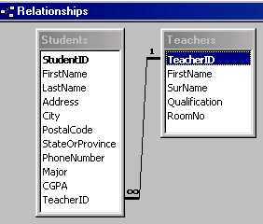
Example of One-to-Many Relationship (in Access)
Example: A teacher can teach many students, and each student have one class teacher.

Slide 40
Many-to-Many Relationship
Meaning - When an entry can occur more than once on both sides of the relationship.
Examples
Each student can take many classes, and each class can contain many students.
Student
Class
Each order contains many products, and each product can be listed in many orders.
Order
Product

Slide 41
Exercise for Students
Identify the entities, attributes and relationships in the following diagram.
CustomerID (PK)
CustomerName
CustomerAddress
CustomerTelephone
ReceiptNo (PK)
CustomerID (FK)
SalesDate
ProductCode (FK)
ProductCode (PK)
ProductDescription
SupplierID (FK)
QuantityInHand
Selling Price
Customer
Sale
Product
SupplierID (PK)
SupplierName
SupplierAddress
SupplierTelephone
Supplier

Slide 42
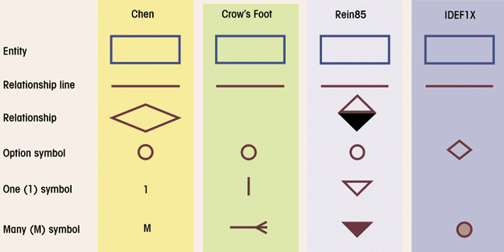
ERD Notation
We only use this for examination and assignment submission

Slide 43
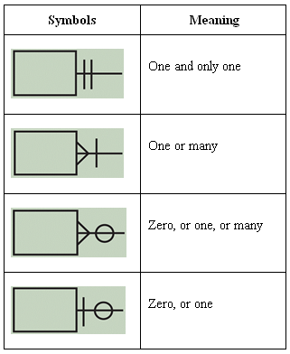
Crow’s Foot Notation
Cardinality
Expresses minimum and maximum number of entity occurrences associated with one occurrence of related entity
Established by very concise statements known as business rules
Important Note:
These are the only symbols to be used in tests and exam questions
From this slide onwards, these correct Crow’s foot notation should be used

Slide 44
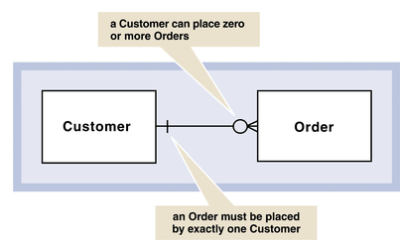
Crow’s Foot Notation
Describes the cardinality of relationship between two entities
Shows how instances of one entity relate to instances of another entity.
Because all relationships are bidirectional, cardinality must be defined in both directions for every relationship.

Slide 45
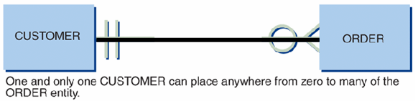
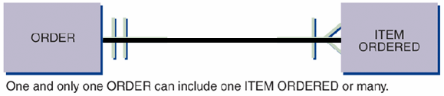
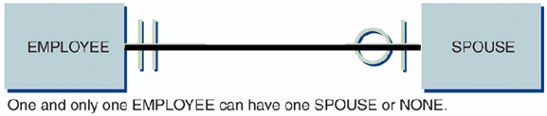
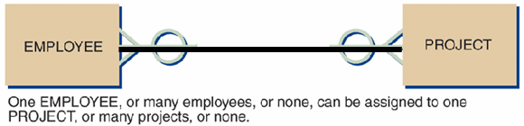
Crow’s Foot Notation
Ex:
Rewrite the relationships in both directions

Slide 46
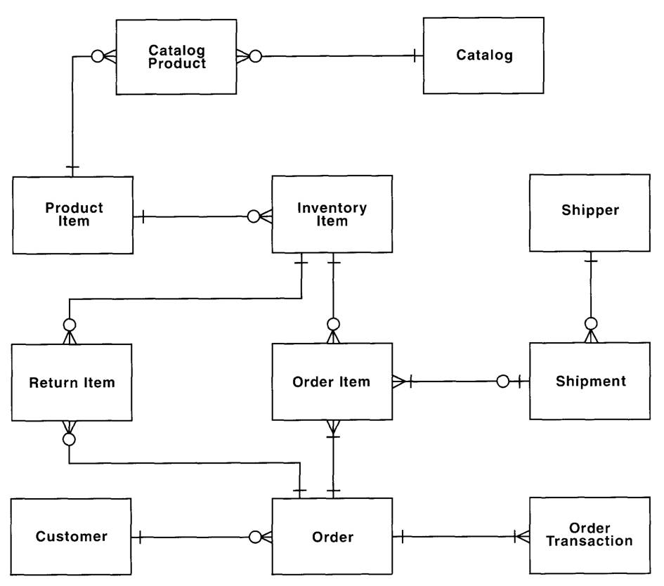
Example 1 of ERD

Slide 47
Example 2 of ERD
Customer
Region
Supplier
Entities
Order
Product
Relationships
Despatch Note

Slide 48
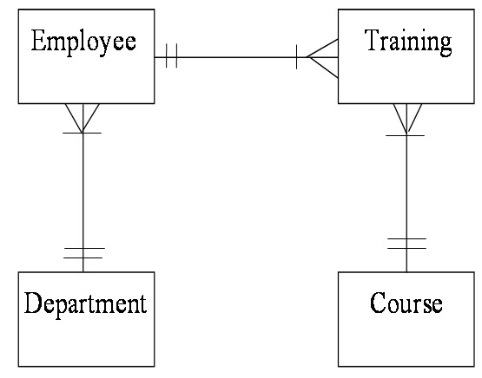
Example 3 of ERD

Slide 49
Example 4 of ERD
Supplier
Product
Customer
Purchase
Sales
Stock
Order
Order
Purchase
Sales
Items
Items

Slide 50
Resolving Many-to-Many Relationship
Associative Entities
Also known as weak entities.
Used to resolve M:N relationships.
Composed of primary keys of each of the entities to be connected.
By introducing an ‘associative’ entity to form a new 2 pairs of one-to-many relationships.
M: N 🡪 1: M
M: 1

Slide 51

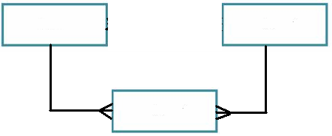
Example 1 – Associative Entity
By introducing an ‘associative’ entity to form a new 2 pairs of one-to-many relationships.
Before
Customer
Product
After
Customer
Product
Order
Associative Entity

Slide 52
Example - Attributes
Product
Reconsider relationship between Product and Order!!! M:N
Customer
Order
CUSTOMER
ORDER
PRODUCT
CustomerID (PK)
LastName
FirstName
Address
PostCode
City
Phone
CustomerID
ProductID
PurchaseDate
Amount
ProductID (PK)
Name
UnitPrice
Identify the keys in ORDER entity

Slide 53
Example 2 - Resolving M:N Relationship
Advisor
Student
Advisor
Student
Course
Course
Grade
Associative entity

Slide 54
Example 3 – Resolving M:N Relationship
Member
Video
Member
Video
Rental
Associative entity

Slide 55
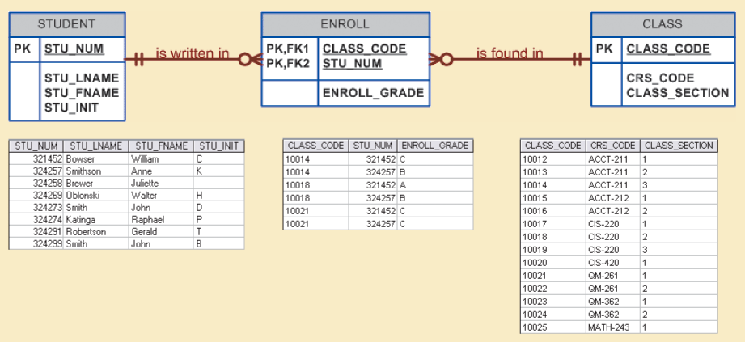
Example 4 – Resolving M:N Relationship

Slide 56
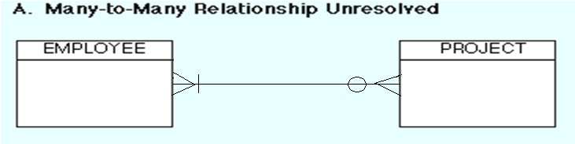
Exercise for Students
We normally do NOT implement M:N relationships in a relational database environment because they create many redundancies.
They must be split into 2 pairs of 1:M relationships by creating an associative entity.
Question - Each employee can be assigned to many projects, and each project can be done by many employees (below).
Resolve the many-to-many relationship
List some attributes for each entity
EMPLOYEE
PROJECT

Slide 57
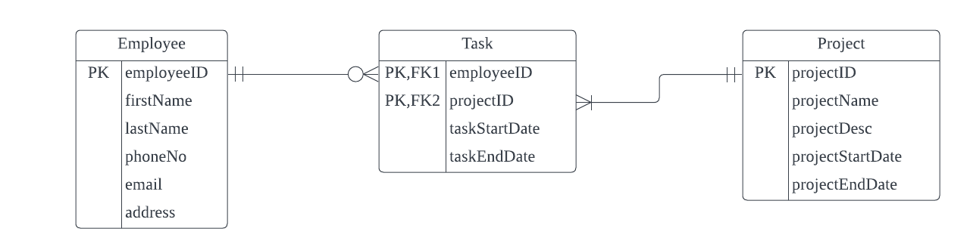
Answer

Slide 58
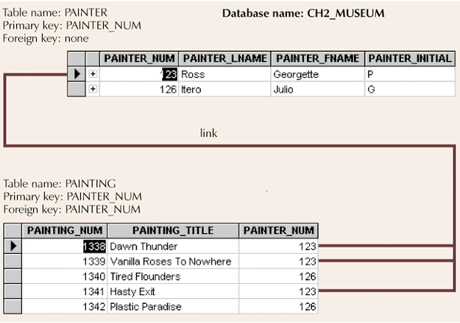
Exercise for Students
Task: Describe the relationship between the painter and the painting

Slide 59
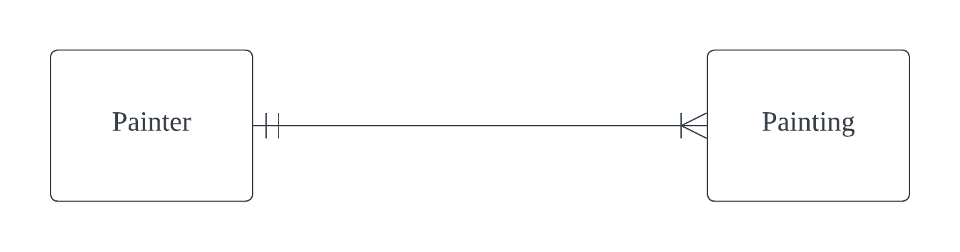
Answer
Business Rule:
One painter is allow to paint for many painting. One painting is assign to only one painter.
Entity Relationship Diagram:

Slide 60
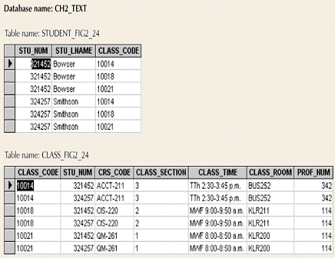
Exercise for Students
Resolve the following many-to-many relationship

Slide 61
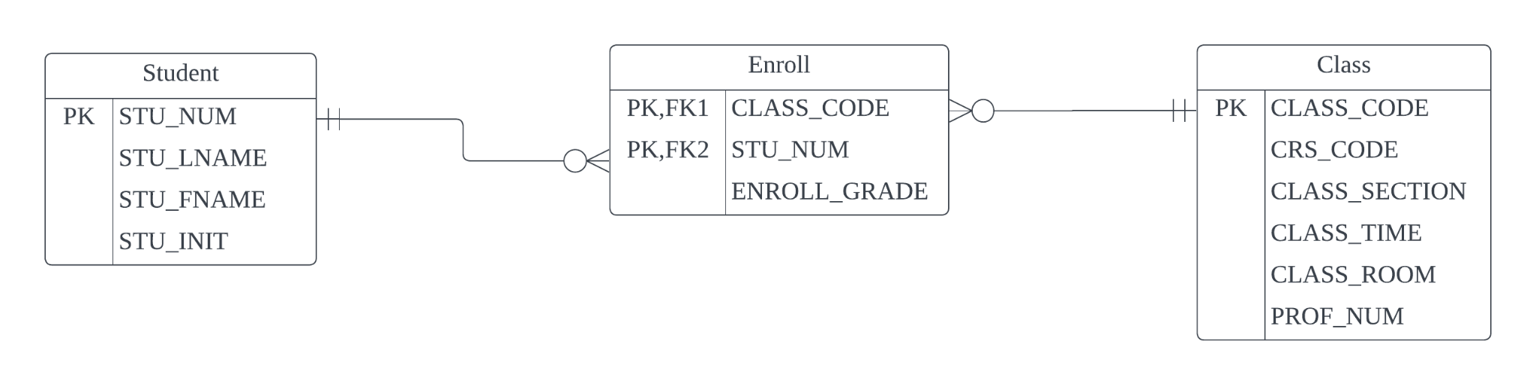
Answer for Students

Slide 62
Relationship Degree
Indicates number of entities or participants associated with a relationship
Unary relationship
Association is maintained within single entity
Binary relationship
Two entities are associated
Ternary relationship
Three entities are associated

Slide 63
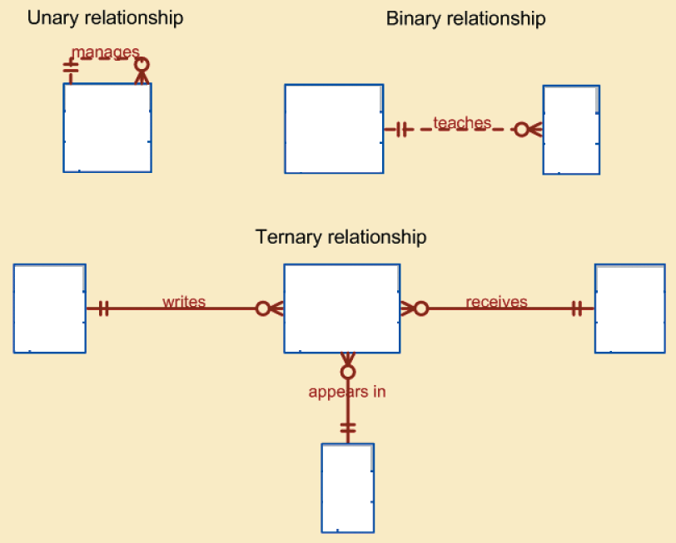
Relationship Degree
Employee
Professor
Class
Doctor
Prescription
Patient
Drug

Slide 64
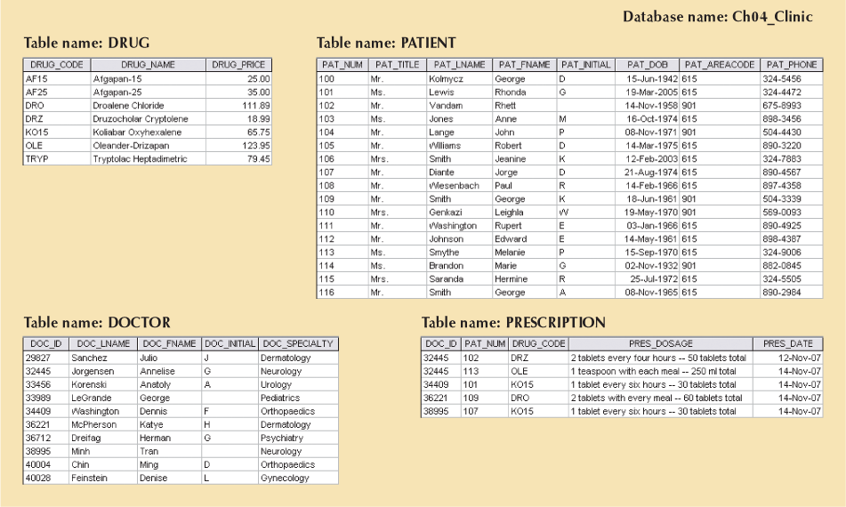
Example of Ternary Relationship

Slide 65
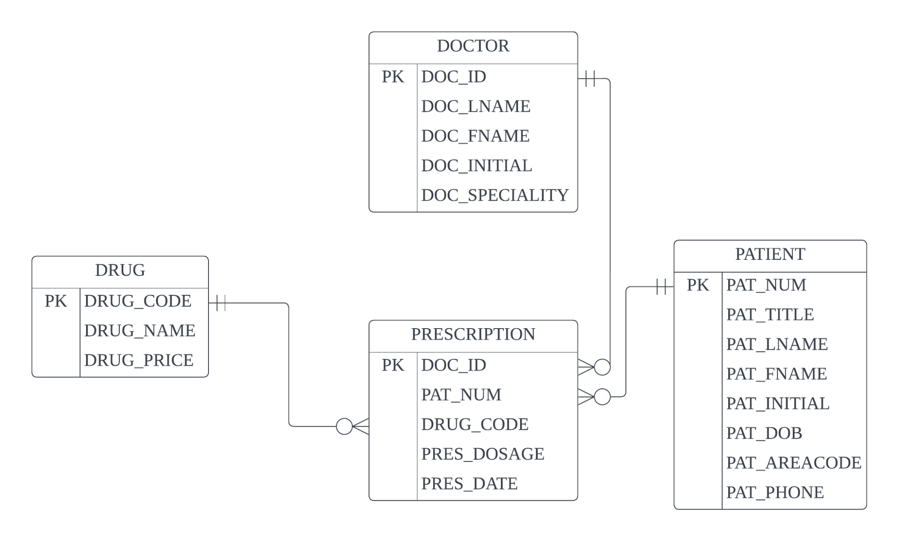
Example

Slide 66
The Entity Relationship Model
Advantages
Exceptional conceptual simplicity
Visual representation
Effective communication tool
Integrated with the relational data model

Slide 67
The Entity Relationship Model
Disadvantages
Limited constraint representation
Limited relationship representation
No data manipulation language
Loss of information content

Slide 68
Exercise for Students
Customer
Invoice
Invoice Line
Product
Describe the above relationships and correct the errors in the use of crows’ foot symbols

Slide 69
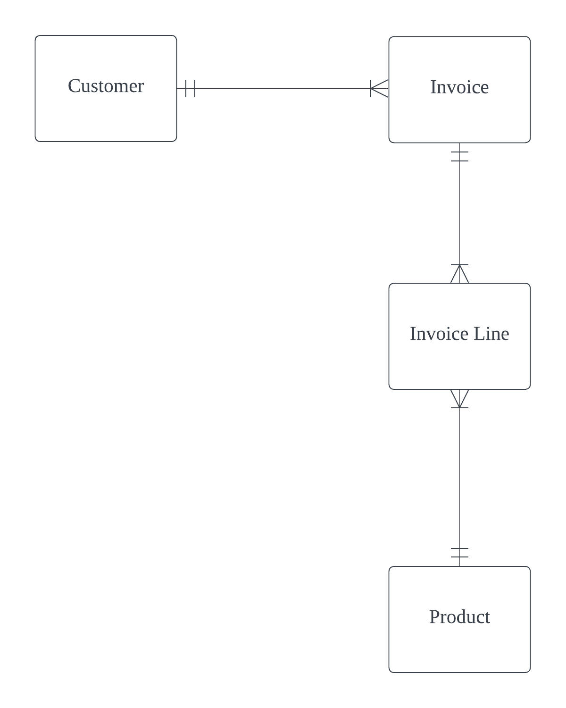
Answer
Business Rules:
One customer will receive one or more invoice. One invoice is issued to only one customer.
One invoice exists in many invoice line. One invoice line belongs to one invoice.
One invoice line can have one product. One product is exists in many invoice line.
ERD in Crow’s foot notation

Slide 70
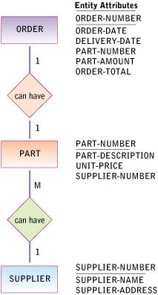
Example of ERD
EXERCISE: Redraw this ERD using Crow’s Foot notations.
Identify the various keys

Slide 71
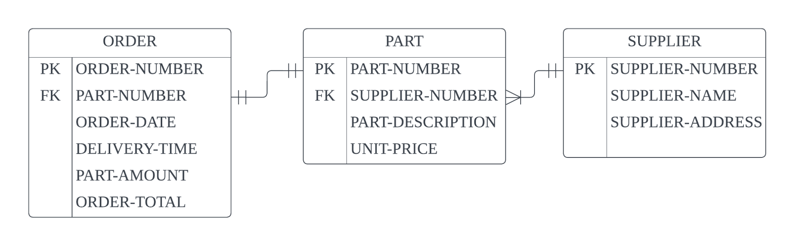
Answer

Slide 72
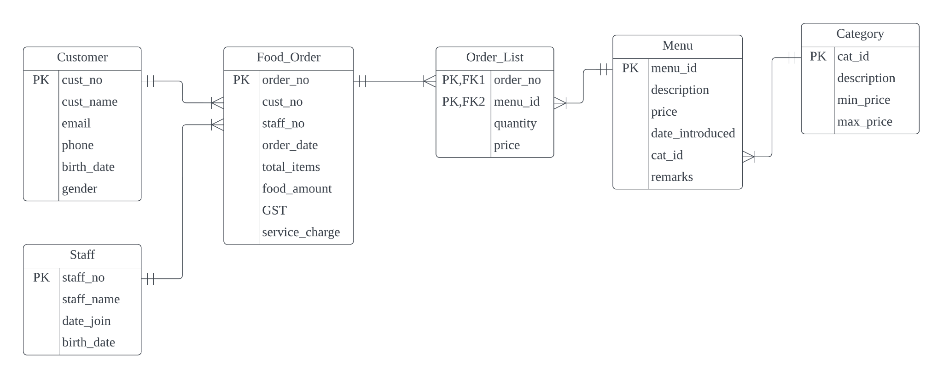

Slide 73
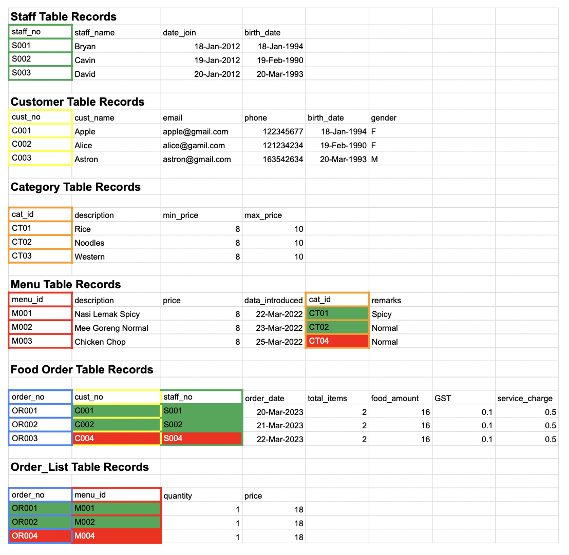

Slide 74
The Object-Oriented Model
In the object-oriented data model (OODM), both data and its relationships are contained in a single structure known as an object.
OODM becomes the basis for the object-oriented database management system (OODBMS).

Slide 75
The Object-Oriented Model
Why OO?
Conventional data models (e.g., relational) are
Inadequate
Can’t model complex and unstructured data
Can’t model processes (dynamic behaviour)
Doesn’t support reuse
A more ‘natural’ way to represent the real world
Encapsulation – incorporating both data and functions in a unit where they are protected from modification from outside.
Notes:
Encapsulation is a way to restrict the direct access to some components of an object
Encapsulation is like a protected layer which include a contain of both data and functions in it which is not allow anyone to modify from outside.

Slide 76
Object-Oriented Data Model - Basic Structure
An object is an abstraction of a real-world entity.
Attributes describe the properties of an object. For example, a PERSON object includes the attributes Name and Date of Birth.
Classes are organized in a class hierarchy. For example, the CUSTOMER class and the EMPLOYEE class share a parent PERSON class.

Slide 77
Object-Oriented Data Model - Basic Structure
Inheritance is the ability of an object within the class hierarchy to inherit the attributes and methods of classes above it. For example, two classes, CUSTOMER and EMPLOYEE, can be created as subclasses from the class PERSON. In this case, CUSTOMER and EMPLOYEE will inherit all attributes and methods from PERSON.
Object-oriented data models are typically depicted using Unified Modeling Language (UML) class diagrams. UML is a language based on OO concepts that describes a set of diagrams and symbols you can use to graphically model a system.
Notes:
It is a mechanism where you can to derive a class from another class for a hierarchy of classes that share a set of attributes and methods.

Slide 78
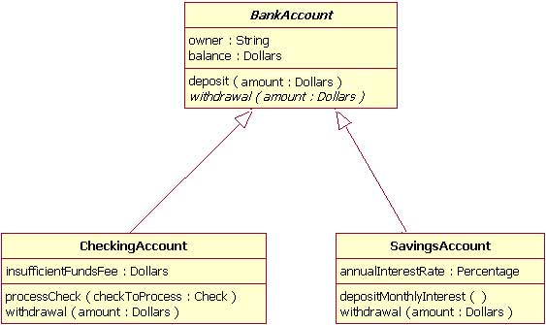
Example of Class Diagram in UML

Slide 79
The Object Oriented Model
Advantages
Adds semantic content
Visual presentation includes semantic content
Database integrity
Both structural and data independence

Slide 80
The Object Oriented Model (continued)
Disadvantages
Slow pace of OODM standards development
Complex navigational data access
Steep learning curve
High system overhead slows transactions
Lack of market penetration

Slide 81
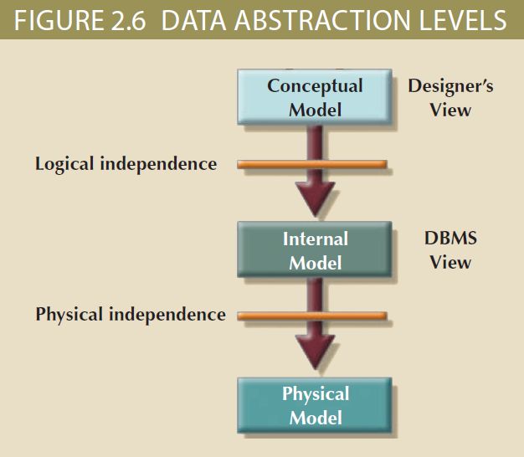
Data Abstraction Levels
Used in various stages of database design

Slide 82
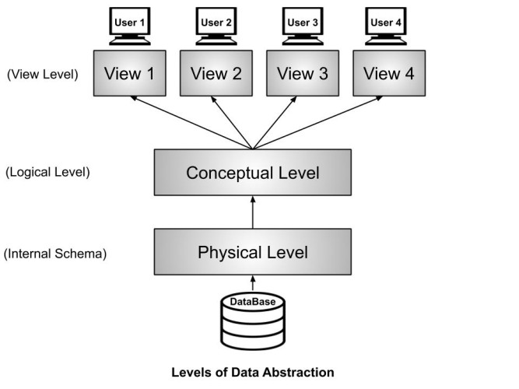
Data Abstraction Levels
In DBMS, there are 3 levels of data abstraction:
Physical Level or Internal Level: This is the layer where the raw data is stored in file format on physical hard drives.
Logical Level or Conceptual Level: In this layer, the raw data is taken from the physical layer and organized in a proper structure, like in tabular format.
View Level or External Level: At this level, the end users get the data depending on the queries. The same data can be viewed in multiple ways, like tables, graphs, or pie charts.

Slide 83
Conceptual Data Model
A conceptual data model identifies the highest-level relationships between different entities.
Features of conceptual data model include:
Includes the important entities and the relationships among them.
No attribute is specified.
No primary key is specified.

Slide 84
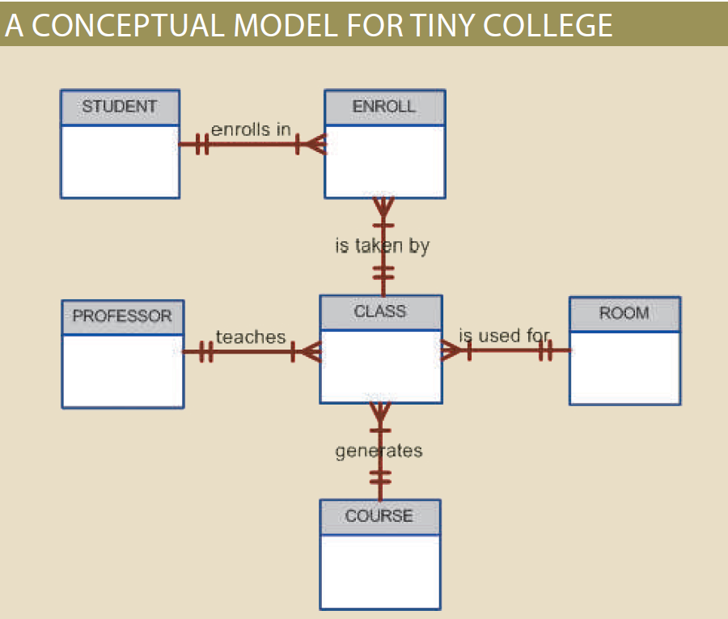
Example:

Slide 85
Advantages of Conceptual Model
It provides a bird’s eye view of the data environment that is easy to understand.
It is independent of both software and hardware.
Software independence means that the model does not depend on the DBMS software.
Hardware independence means that the model does not depend on the hardware used in the implementation of the model.
Therefore, changes in either the hardware or the DBMS software will have no effect on the database design at the conceptual level.

Slide 86
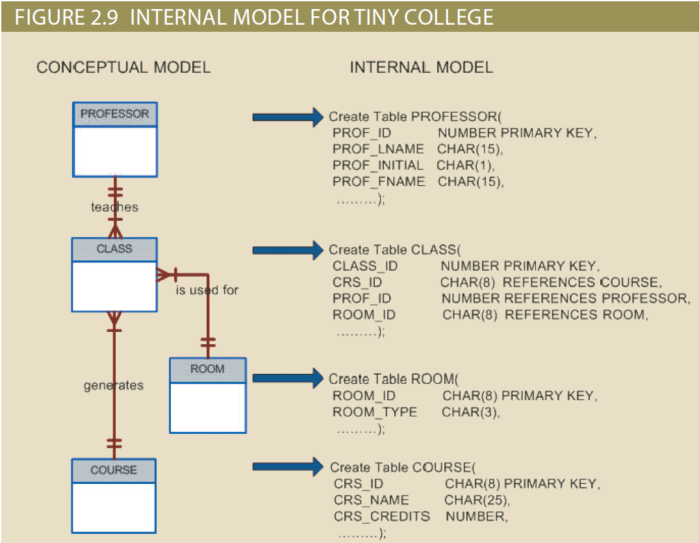
From Conceptual Model To Internal Model

Slide 87
Data Dictionary
Data dictionary provides a detailed description of all tables in the database created by the user and designer. Thus, the data dictionary contains at least all of the attribute names and characteristics for each table in the system.
In short, the data dictionary contains metadata (data about data).

Slide 88
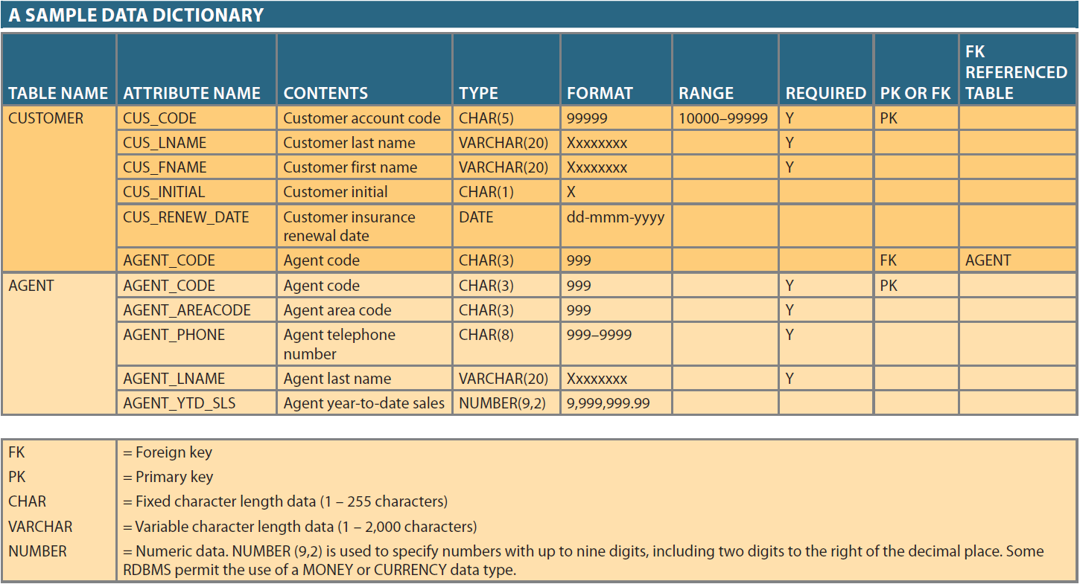

Slide 89
Why are Data Dictionaries Important?
To document the data about the data (metadata) in the system.
To locate errors and omissions in the system.
To communicate a common meaning for all of the elements in the system.

